Slide 1


NoSQL Databases
Department of Computer Science Engineering
School of Engineering

Slide 2
Module 2 : Document Data Model
Topics: Characteristics of Document Data Model, Collection, Naming, CRUD Operation, Querying, Indexing, Replication, Sharding, Consistency, Update Consistency, Read Consistency, Relaxing Consistency, Capped Collection.
[6Hrs.] [Knowledge]

Slide 3
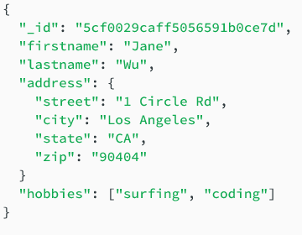
Documents
What are Documents?
A document is a record in a document database. A document typically stores information about one object and any of its related metadata.
Documents store data in field-value pairs.
The values can be a variety of types and structures, including strings, numbers, dates, arrays, or objects.
Documents can be stored in formats like JSON, BSON, and XML.

Slide 4
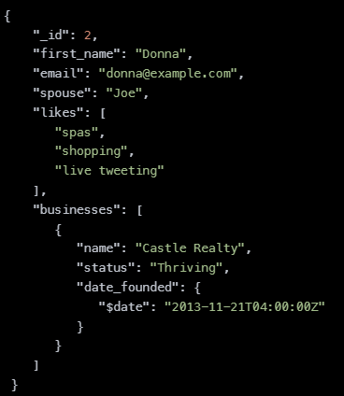
Collections
A collection is a group of documents. Collections typically store documents that have similar contents.
Not all documents in a collection are required to have the same fields, because document databases have a flexible schema.

Slide 5
Naming
MongoDB has some naming conventions. One of them is that database names are case insensitive.
Example :
Database
camelCase: append DB to the end of the name (e.g. myDB, myNewDB)
Collections & document fields
Lowercase names (collection names in MongoDB are case-sensitive)
Plural collections (e.g. users rather than user)
No word separators when possible – although I use CamelCase when not possible with perhaps only two separate words max; e.g. firstName, lastName.

Slide 6
Key Features of Document Databases
Document model: Data is stored in documents (unlike other databases that store data in structures like tables or graphs). Documents map to objects in the most popular programming languages, which allows developers to rapidly develop their applications.
Flexible schema: Document databases have a flexible schema, meaning that not all documents in a collection need to have the same fields.
Distributed and resilient: Document databases are distributed, which allows for horizontal scaling (typically cheaper than vertical scaling) and data distribution. Document databases provide resiliency through replication.

Slide 7
Key Features of Document Databases
Querying through an API or query language: Document databases have an API or query language that allows developers to execute the CRUD operations on the database. Developers have the ability to query for documents based on unique identifiers or field values.

Slide 8
Strengths and Weaknesses of Document Databases
Strengths :
Document Model
Flexible Schema
APIs and Query Languages
Distributed and Resilient.
Weakness:
A common weakness that people cite about document databases is that many do not support multi-document ACID transactions.

Slide 9
Use Cases for Document Databases
Document databases are general-purpose databases that serve a variety of use cases for both transactional and analytical applications:
Single view or data hub
Customer data management and personalization
Internet of Things (IoT) and time-series data
Product catalogs and content management
Payment processing
Mobile apps
Mainframe offload
Operational analytics
Real-time analytics

Slide 10
CRUD operations
Document databases typically have an API or query language that allows developers to execute the CRUD (create, read, update, and delete) operations.
Create: Documents can be created in the database. Each document has a unique identifier.
Read: Documents can be read from the database. The API or query language allows developers to query for documents using their unique identifiers or field values.
Update: Existing documents can be updated — either in whole or in part.
Delete: Documents can be deleted from the database.

Slide 11
Querying
A query in a database system is a command that is used for extracting data from a database and displaying it in a readable form.
Every query associated with the database system is associated with any particular language (such as SQL for structured data, and MongoDB for unstructured data).
Example:
The find() method: This method is used for querying data from a MongoDB collection.
Syntax: db. Collection_name.find()
(i.e) db.students.find()

Slide 12
Querying (Cont…)
The pretty() method: This method is used for giving a proper format to the output extracted by the query.
Syntax: db. Collection_name.find().pretty()
(i.e) db.students.find().pretty()
OR Condition: MongoDB allows users to specify either one or multiple values to be true. According to this, till one of the conditions is true, the document data will get returned. Here is an example.
Example : db.students.find().( {$or : [ { Regno: “202” }, {From:”Rajankunte”}]})

Slide 13
Indexing
Indexes support the efficient resolution of queries.
Without indexes, MongoDB must scan every document of a collection to select those documents that match the query statement.
This scan is highly efficient and requires MongoDB to process a large volume of data.
Indexes are special data structures, that store a small portion of the data set in an easy-to-traverse form.
The index stores the value of a specific field or set of fields, ordered by the value of the field as specified in the index.

Slide 14
Indexing (Cont..)
createIndex() Method : To create an index, you need to use createIndex() method of MongoDB.
Syntax: db. Collection_name.createIndex({KEY:1})
Here the key is the name of the field on which you want to create the index and 1 is for ascending order. To create an index in descending order you need to use -1.

Slide 15
Replication
Replication is the process of synchronizing data across multiple servers.
Replication provides redundancy and increases data availability with multiple copies of data on different database servers.
Replication protects a database from the loss of a single server.
Replication also allows you to recover from hardware failure and service interruptions.
With additional copies of the data, you can dedicate one to disaster recovery, reporting, or backup.

Slide 16
Why We Want Replication?
To keep your data safe
High (24*7) availability of data
Disaster recovery
No downtime for maintenance (like backups, index rebuilds, compaction)
Read scaling (extra copies to read from)
Replica set is transparent to the application

Slide 17
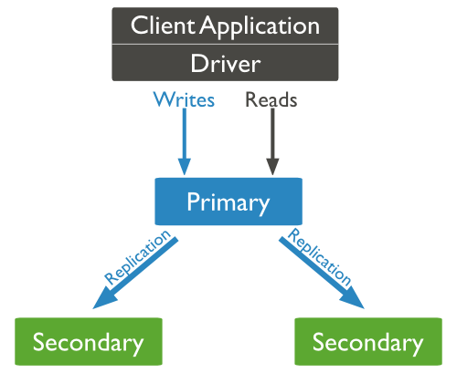
How Replication Works in MongoDB ?
MongoDB achieves replication by the use of a replica set.
A replica set is a group of mongod instances that host the same data set. In a replica, one node is a primary node that receives all write operations.
All other instances, such as secondaries, apply operations from the primary so that they have the same data set.
The replica set can have only one primary node.

Slide 18
How Replication Works in MongoDB ? (Cont..)
Replica set is a group of two or more nodes (generally minimum of 3 nodes are required).
In a replica set, one node is primary node and the remaining nodes are secondary.
All data replicates from the primary to the secondary node.
At the time of automatic failover or maintenance, election establishes for primary and a new primary node is elected.
After the recovery of failed node, it again join the replica set and works as a secondary node.

Slide 19
Replica Set Features
A cluster of N nodes
Any one node can be primary
All write operations go to primary
Automatic failover
Automatic recovery
Consensus election of primary

Slide 20
Replica Set SetUp
The shutdown already running MongoDB server.
Start the MongoDB server by specifying -- replSet option. Following is the basic syntax of --replSet −
Syntax : mongod --port "PORT" --dbpath "YOUR_DB_DATA_PATH" --replSet "REPLICA_SET_INSTANCE_NAME“
Example : mongod --port 27017 --dbpath "D:\set up\mongodb\data" --replSet rs0

Slide 21
Sharding
Sharding is the process of storing data records across multiple machines and it is MongoDB's approach to meeting the demands of data growth.
As the size of the data increases, a single machine may not be sufficient to store the data nor provide an acceptable read and write throughput.
Sharding solves the problem with horizontal scaling. With sharding, you add more machines to support data growth and the demands of reading and writing operations.

Slide 22
Why Sharding ?
In replication, all writes go to the master node
Latency-sensitive queries still go to master
The single replica set has a limitation of 12 nodes
Memory can't be large enough when the active dataset is big
The local disk is not big enough
Vertical scaling is too expensive

Slide 23
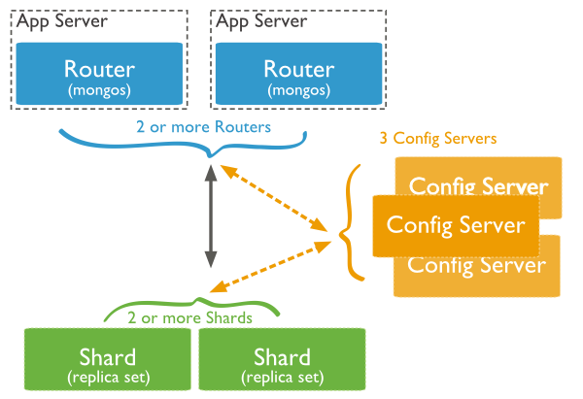
Sharding in MongoDB
Shards − Shards are used to store data.
Config Servers − Config servers store the cluster's metadata.
Query Routers − Query routers are basically mongo instances, interface with client applications and direct operations to the appropriate shard.

Slide 24
Consistency
Consistency is the property of the database management systems in which a consistent state is maintained in the database.
Example :
If the transaction happened successfully, all the changes will be applied to the database
If the transaction does not happen successfully due to any error or system failure, in this case, the changes will be rolled back and the database will be maintained to its original state where it was before the transaction began.

Slide 25
Consistency in MongoDB
MongoDB supports consistency and in it, the data is consistent by default. The applications can read and write to MongoDB replica sets,
For MongoDB, the primary members of a replica set, the read and write are consistent.
Sometimes, the applications also read from the secondary replica sets. In this case, for the MongoDB secondary members of the replica set, the data is eventually consistent by default.
(i.e) The term “eventual consistency” means to have copies of data on multiple machines to get high availability and scalability.

Slide 26
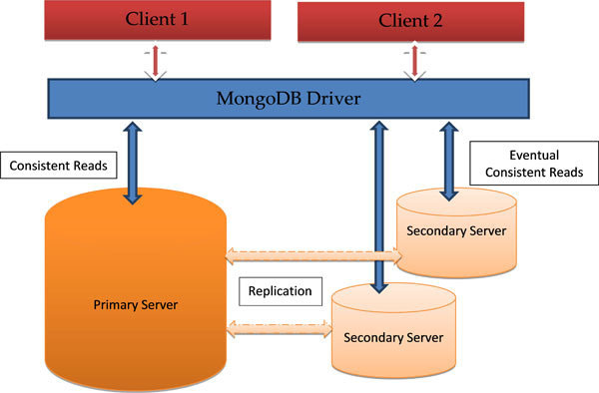
Consistency in MongoDB (Cont..)

Slide 27
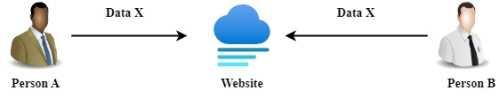
Update Consistency
Write-Write Conflict: Two People Updating the Same Data at the Same Time.
When These Writes reach the server, the Server Will Serialize Them After one Other.

Slide 28
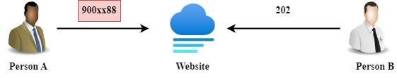
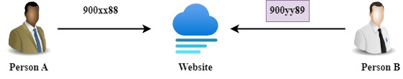
Update Consistency (Contd..)

Slide 29
Update Consistency (Contd..)
Person A – Update is Overwritten By Person B- Update.
(i.e) Whatever Phone Number is Updated by Person A is known as a lost update this is called failure consistency(Actually Lost Update is not a big problem)

Slide 30
Update Consistency (Contd..)
Approaches for Maintaining Consistency :
Pessimistic: “ Preventing Conflict”
Common Approach: To Have a write lock in order to change a value you need to acquire a lock and the system ensures that only one client can get a lock at a time.
Considering the previous scenario both(Person A / Person B) attempt to acquire the write lock. But, Only Person A would succeed. So, Person B will see the result of Person A, and then he will decide whether to make an update or not.

Slide 31
Update Consistency (Contd..)
Approaches for Maintaining Consistency :
Optimistic: “Let conflict occur, but detects them and takes action to sort them out.”
Common Approach: Conditional Update, any client that does an update tests the value just before updating it to see if it’s changed since his last read.
In, Previous Scenario, Person A Update would Succeed but person B would fail. The error would let Person B know that he should look at the value again & decide whether to attempt a further update.

Slide 32
Update Consistency (Contd..)
Approaches for Maintaining Consistency :
To Save both updates and record that they are in conflict. (This approach is familiar to many programmers from version control systems)
Version Control: Merge the two updates maybe you show both values to the user and ask them to sort it out or the computer can merge itself.

Slide 33
Update Consistency (Contd..)
Both Updates rely on a consistent serialization of the updates :
Single Server: To Choose one, then the other(Synchronization is done).
Peer-to-Peer (Multi-Server) : Two Nodes Might apply the updates in a different order resulting in a different value for the telephone number on each peer.
“ When people talk about concurrency in distributed systems, they talk about sequential consistency- ensuring that all nodes apply operations in the same order.”

Slide 34
Update Consistency (Contd..)
When People encounter these issues they prefer to go for Pessimistic Concurrency control( try to avoid conflicts) using a single node as the target for all writes for some data makes it much easier to maintain the update consistency.

Slide 35
Read Consistency
Data Store that maintains update consistency does not guarantee that all readers (transaction/users) will always get a consistent database ( as a response to reading requests)
Example: We have an order with line items and a shipping charge. The shipping charge is calculated based on the line items in the order. If we add a line item, we thus also need to recalculate and update the shipping charge

Slide 36
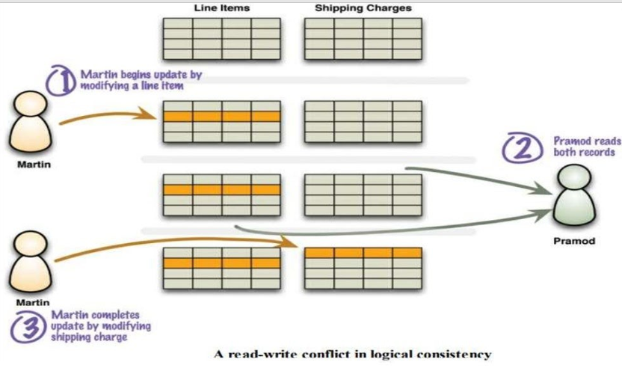
Read Consistency (Contd..)

Slide 37
Read Consistency (Contd…)
Inconsistent Read or Read-Write Conflict
Danger of inconsistency
Martin adds a line item to his order, Pramod then reads the line items and shipping charge, and then Martin Updates the shipping charge. Pramod has done a read in the middle of Martin’s Write.

Slide 38
Read Consistency (Contd…)
Given a Schedule S. T2 Could read a database object A, Modified by T1 which hasn’t committed. This is a dirty read, also known as logical consistency.
Inconsistent Read or Read-Write Conflict
“In, the field of databases, write-read conflict, also known as reading uncommitted data, is a computational anomaly associated with interleaved execution of transactions.”

Slide 39
Read Consistency (Contd…)
Logical Consistency :
To, ensure that different data items make sense together. To avoid a logically inconsistent read-write conflict, RDBMS supports the notion of transactions.
Example: Martin wraps his two writes in a transaction, and the system guarantees that Pramod will either read both data items before the update or both after the update.

Slide 40
Read Consistency (Contd…)
Inconsistency Window:
The Length of time inconsistency is present is called the inconsistency window.
“A NoSQL System may have a quite short inconsistency window. Usually less than a second.”

Slide 41
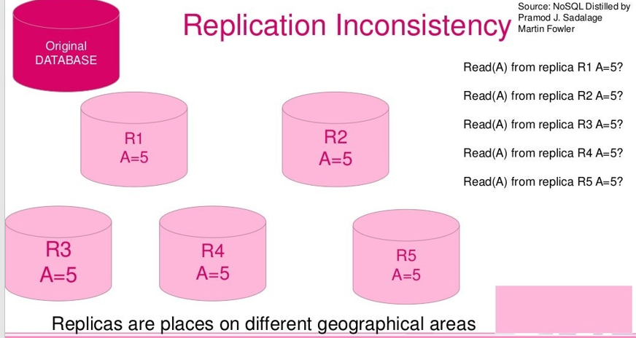
Read Consistency (Contd…)

Slide 42
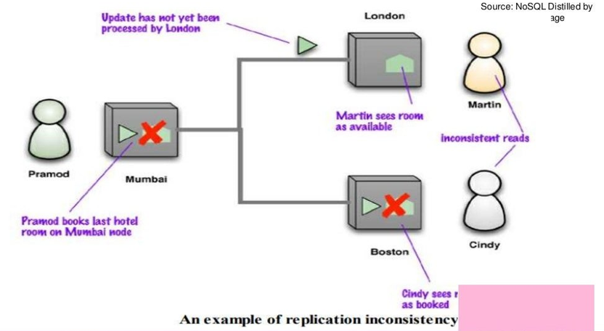
Read Consistency (Contd…)

Slide 43
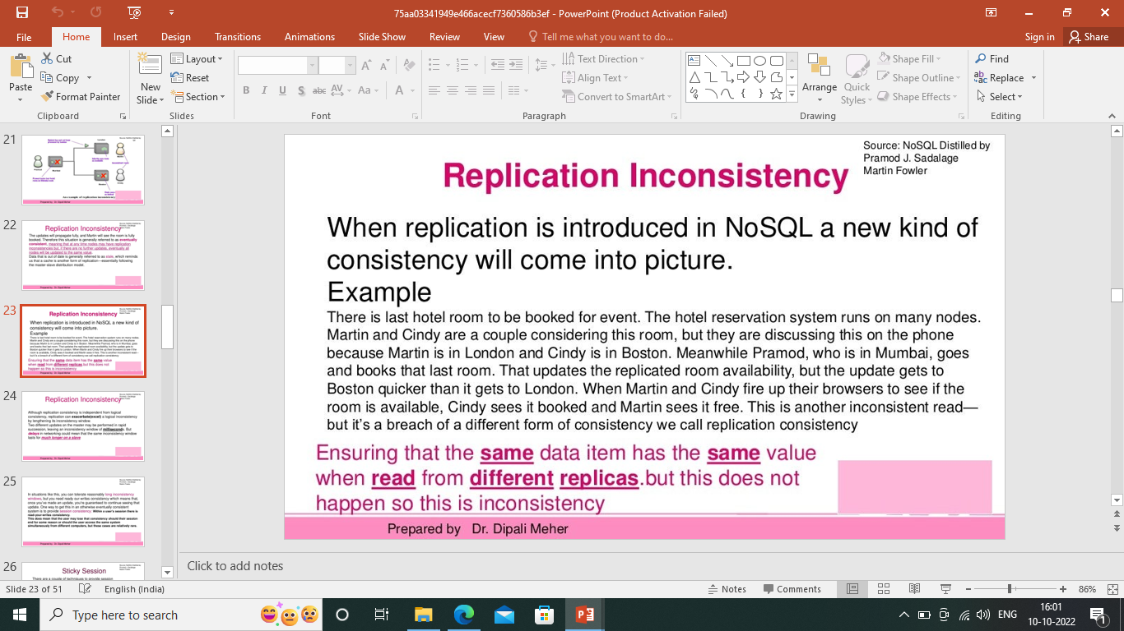
Read Consistency (Contd…)
The Updates will propagate fully, and Martin will see the room is fully booked. Therefore this situation is generally referred to as eventually consistent.

Slide 44
Read Consistency (Contd…)
Sticky Session :
There are a couple of techniques to provide session consistency. A common way, and often the easiest way, is to have a sticky session: a session that’s tied to one node (this is also called session affinity)
“A Sticky Session allows you to ensure that as long as you keep reading –your –writes consistently on a node you will get it for sessions too. The downside is that sticky sessions reduce the ability of the load balancer to do its job.”

Slide 45
Read Consistency (Contd…)
Version Stamps
Another approach for session consistency is to use Version Stamps and ensure every interaction with the data store includes the latest version stamp seen by a session. The Server node must then ensure that it has the updates that include that version stamp before responding to a request.

Slide 46
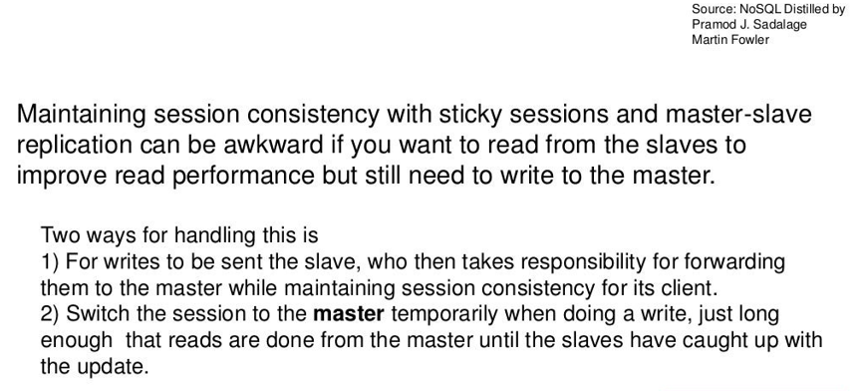
Read Consistency (Contd…)

Slide 47
Relaxing Consistency
Trading Off Consistency is a familiar concept even in single-server relational database systems. But, the principal tool to enforce consistency is the transaction.
Transaction systems usually come with the ability to relax isolation levels, allowing queries to read data that hasn’t been committed yet, and in practice we see most applications relax consistency down from the highest isolation level(serialized) in order to get effective performance.

Slide 48
Relaxing Consistency
Consistency is a Good Thing – but, sadly sometimes we have to Sacrifice it.
It’s always possible to design a system to avoid inconsistencies, but often impossible to do so without making unbearable sacrifices in other characteristics of the system.
As a result, we often have to trade off Consistency for something else.

Slide 49
CAP Theorem
CAP: Consistency, Availability, Partition Tolerance
Consistency: All the nodes see the same data item at the same time.
Availability: Every Request Received By a database node(not fail) should result in the correct response.
Partition Tolerance: The System Continues to operate despite arbitrary partitioning due to network failures.

Slide 50
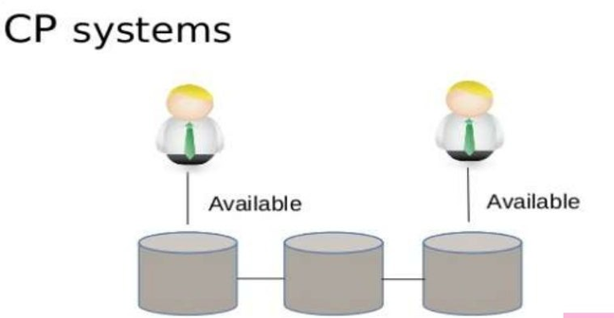
CAP Theorem (Cont’d..)

Slide 51
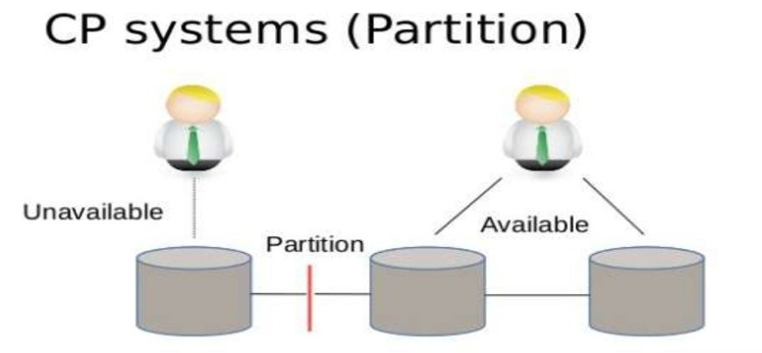
CAP Theorem (Cont’d..)

Slide 52
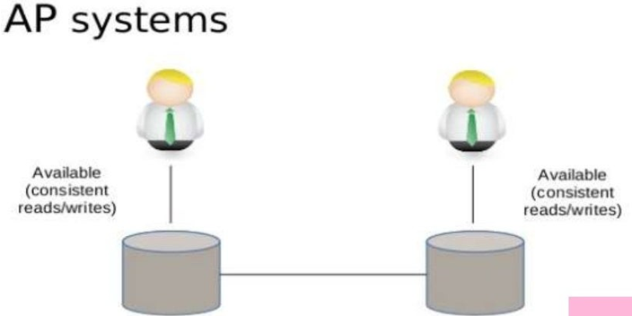
CAP Theorem (Cont’d..)

Slide 53
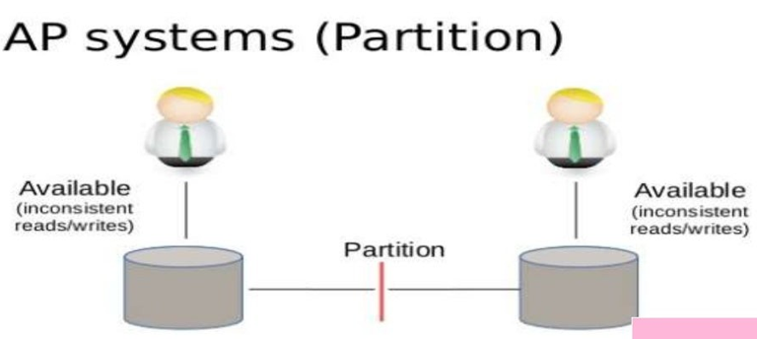
CAP Theorem (Cont’d..)

Slide 54
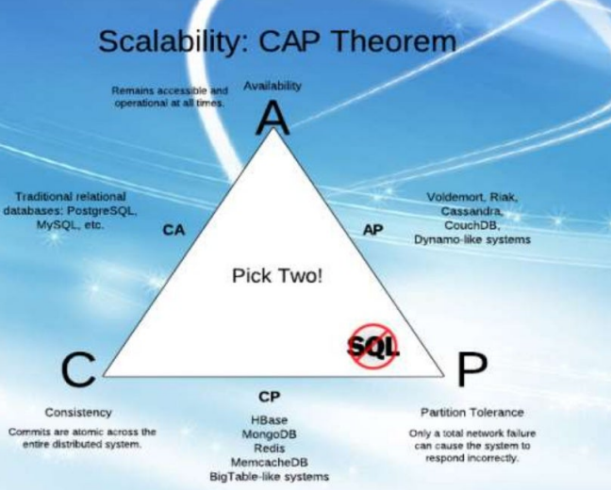
CAP Theorem (Cont’d..)

Slide 55
CAP Theorem (Cont’d…)
The CAP theorem is a tool used to make system designers aware of the trade-offs while designing networked shared–data systems.
Consistency: a guarantee that every node in a distributed cluster returns the same, most recent, and successful write. (Every Client has the same view of data)
Availability: Every non-failing node returns a response for all read and writes requests in a responsible amount of time.
Partition Tolerant: The System continues to function and upholds its consistency guarantees in spite of network partitions.

Slide 56
CAP Theorem (Cont’d…)
The c and a in acid represent different concepts than the c and a in the cap theorem.
CP (consistent and partition tolerance) : CP is referring to a category of systems where availability is sacrificed only in the case of the network.
CA (consistent and available): Single node DB servers categorized as ca systems. single node DB servers do not need to deal with partition tolerance.
AP (available and partition tolerant) : These are the systems that are available and partition tolerant but cannot guarantee consistency.

Slide 57
CAP Theorem (Cont’d…)
The correct way to think about the cap is that in case of a network partition ( a rare occurrence) one needs to choose between availability and consistency.

Slide 58
Summary
RDBMS: To Exhibit Strong Consistency By Avoiding all the various Inconsistencies.
NoSQL : CAP Theorem & Eventual Consistency.
Pessimistic Approach: Lock the data records to prevent conflicts.
Optimistic Approach: Detects Conflicts and Fix them.
To Get good consistency, you need to involve many nodes in data operations, but this increases latency. So, you often have to trade off consistency vs latency.
The CAP Theorem states that if you get a network partition, you have to trade off the availability of data vs consistency.

Slide 59
Summary (Cont’d…)
Durability can also be a trade-off against latency, particularly if you want to survive failures with replicated data. You do not need to contact all replicants to preserve strong consistency with replication; you just need a large enough quorum.

Slide 60
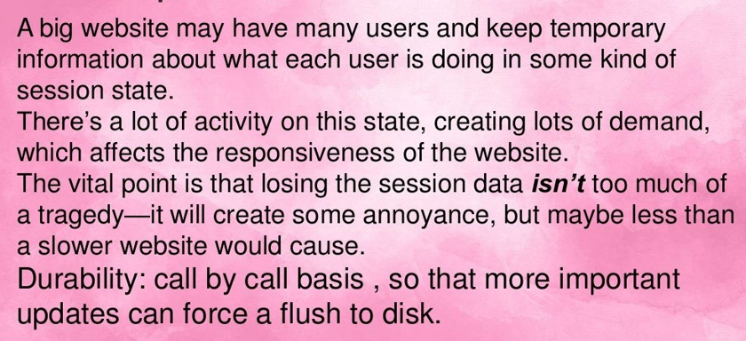
Case Studies
.

Slide 61
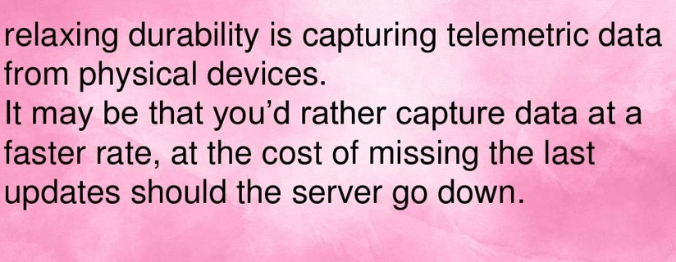
Case Studies (Cont’d…)
.

Slide 62
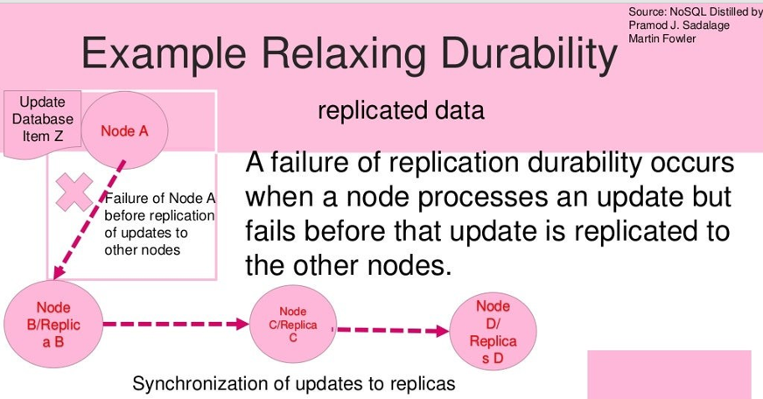
Case Studies (Cont’d…)
.

Slide 63
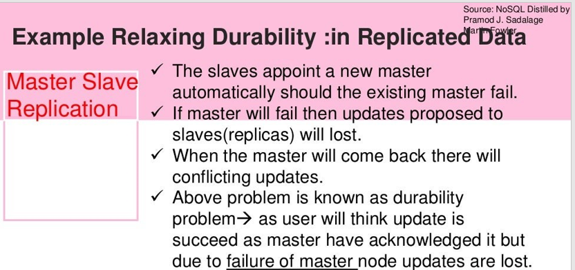
Case Studies (Cont’d…)
.

Slide 64
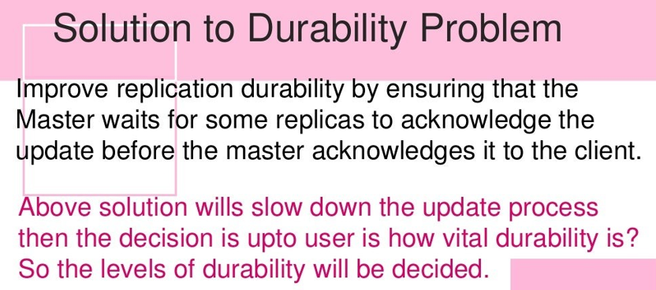
Case Studies (Cont’d…)
.

Slide 65
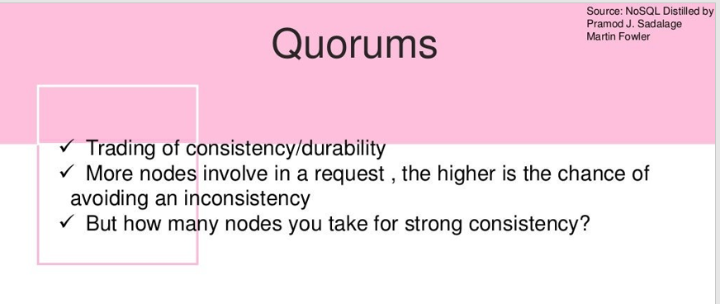
Case Studies (Cont’d…)
.

Slide 66
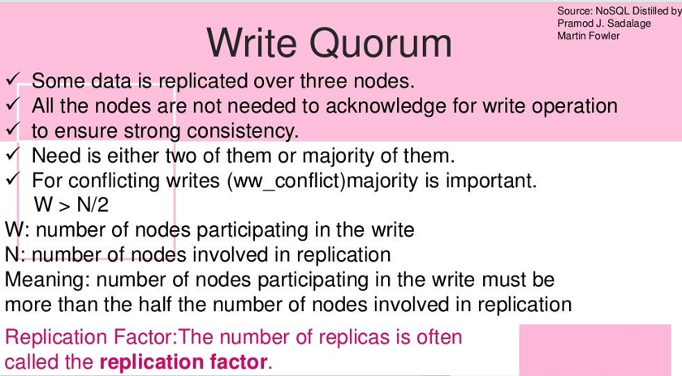
Case Studies (Cont’d…)
.

Slide 67
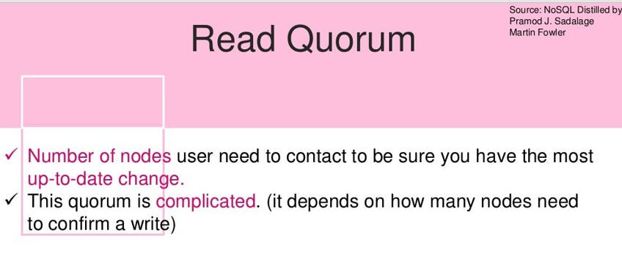
Case Studies (Cont’d…)
.

Slide 68
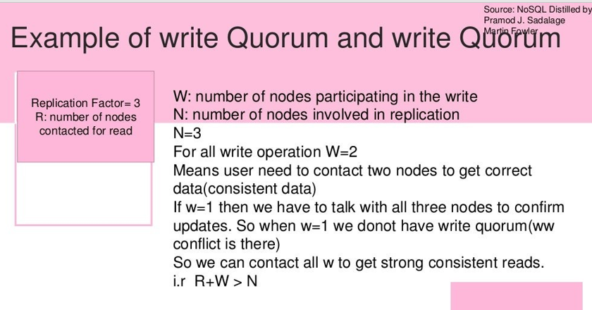
Case Studies (Cont’d…)
.

Slide 69
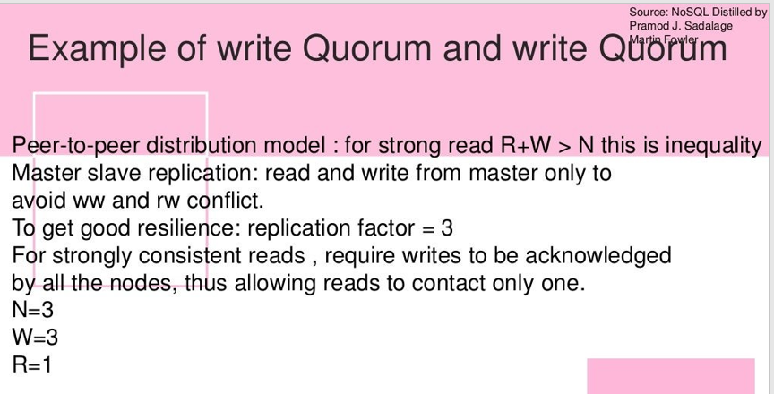
Case Studies (Cont’d…)
.

Slide 70


